Slide 1
UA ASCEND
Fall 2016 and Spring 2017 Launch
Reagan DeVoe, Duffy Elmer, Shobitha Jillela, Alexandria Lund-Coppage, Cathy McIntosh, Andrew Okonya, Joel Thibault, Steve Smith, Andras Szep, and Marton Szep

Slide 2

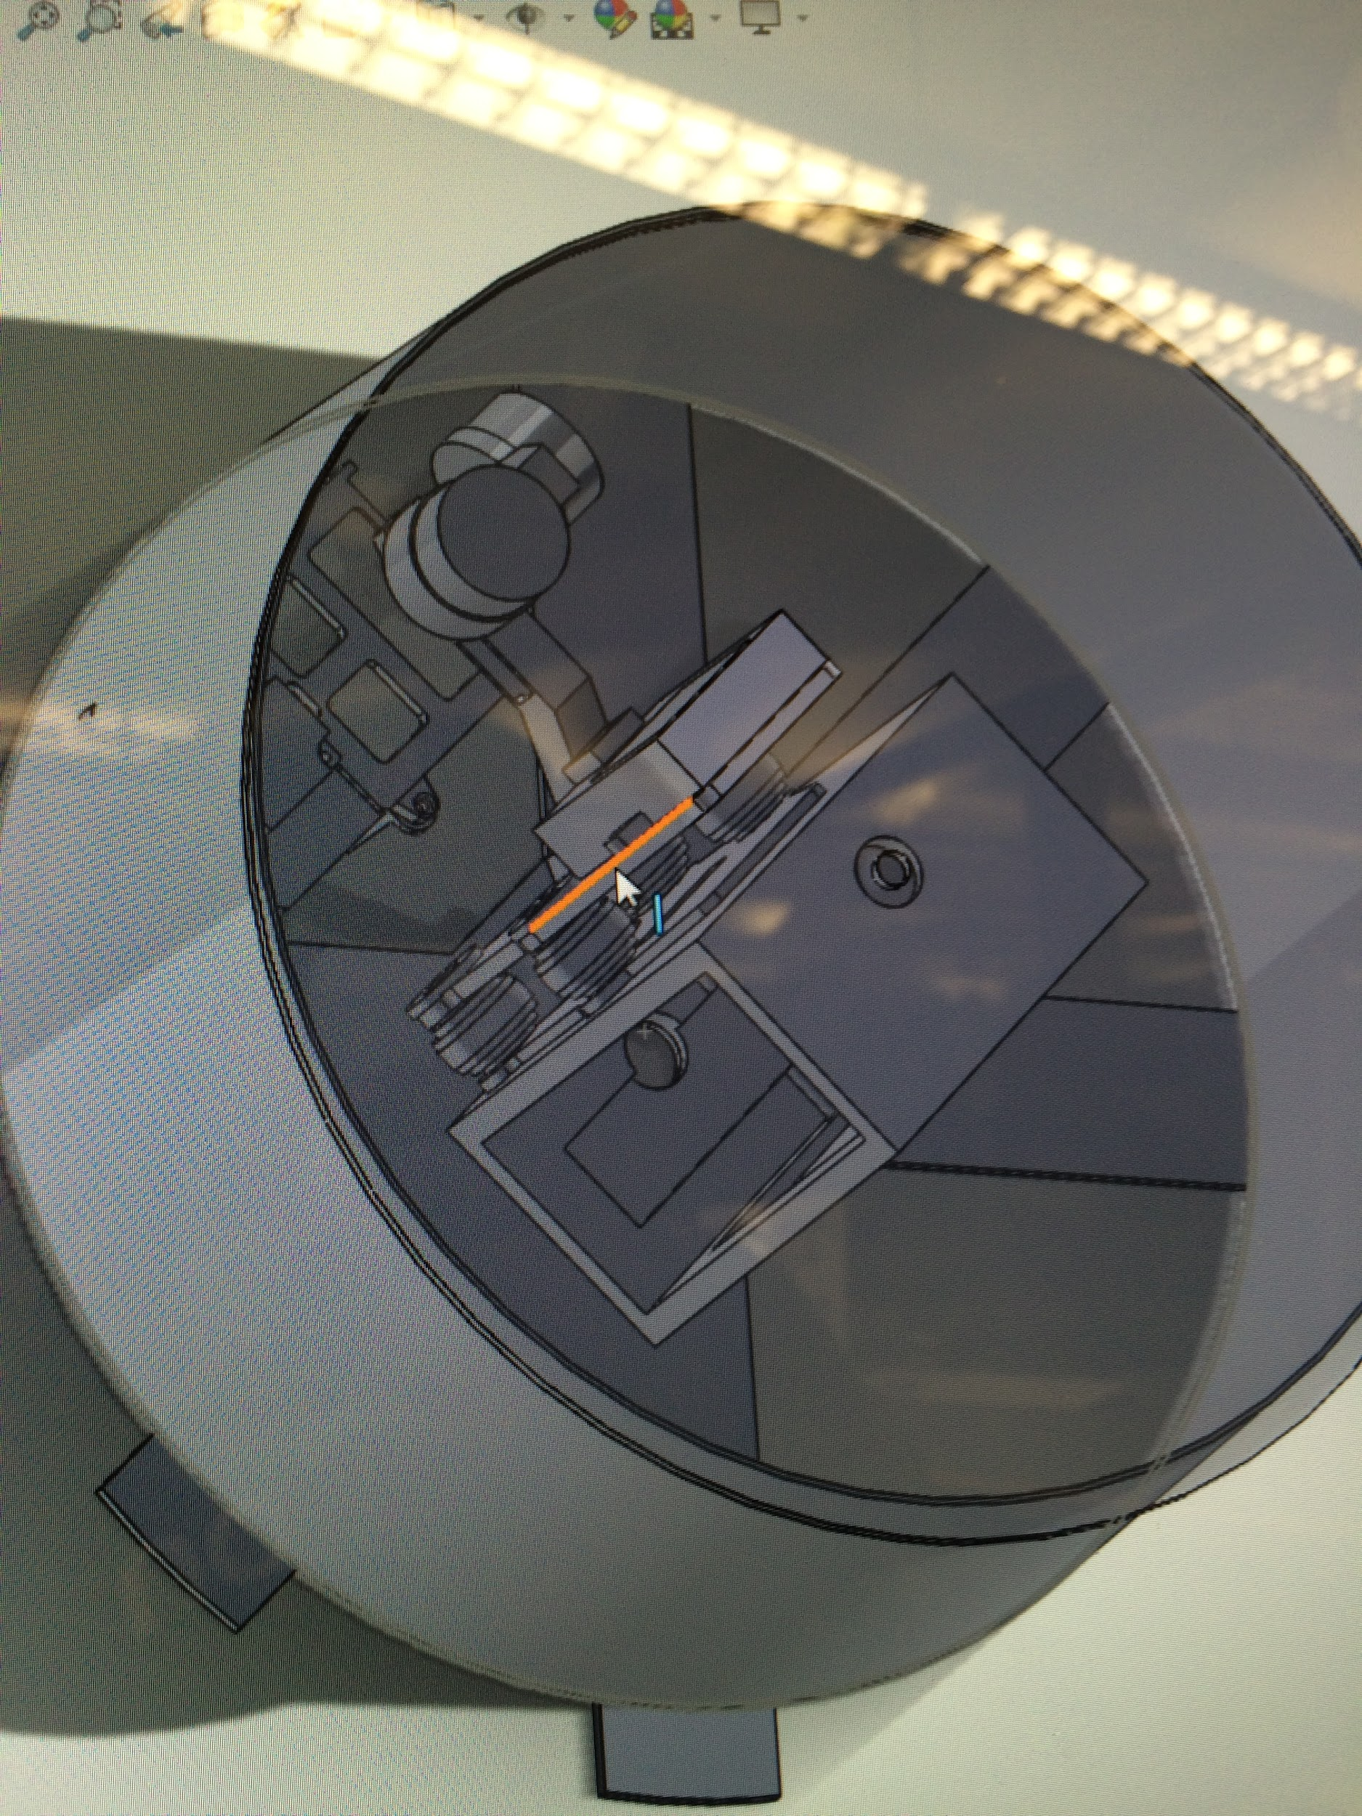
Payload Design
Design planning and CAD
Fabrication
Dynamic and Stress Analysis

Slide 3
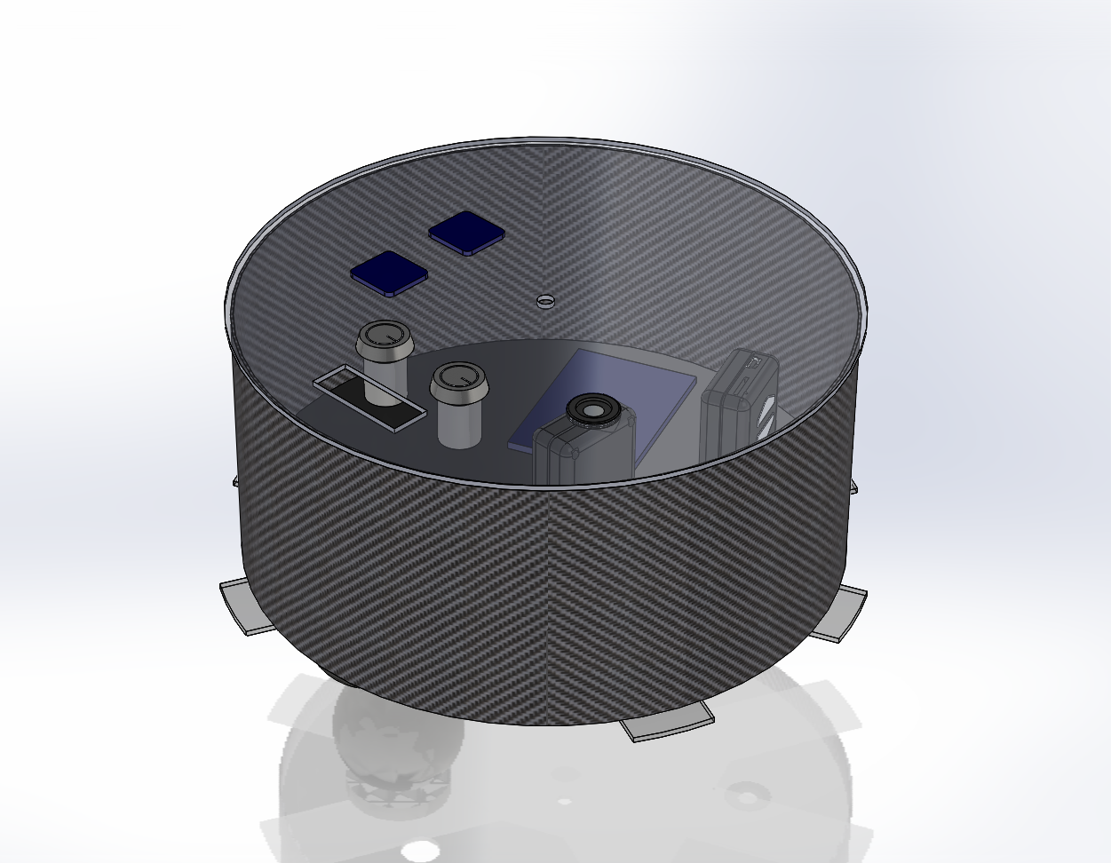
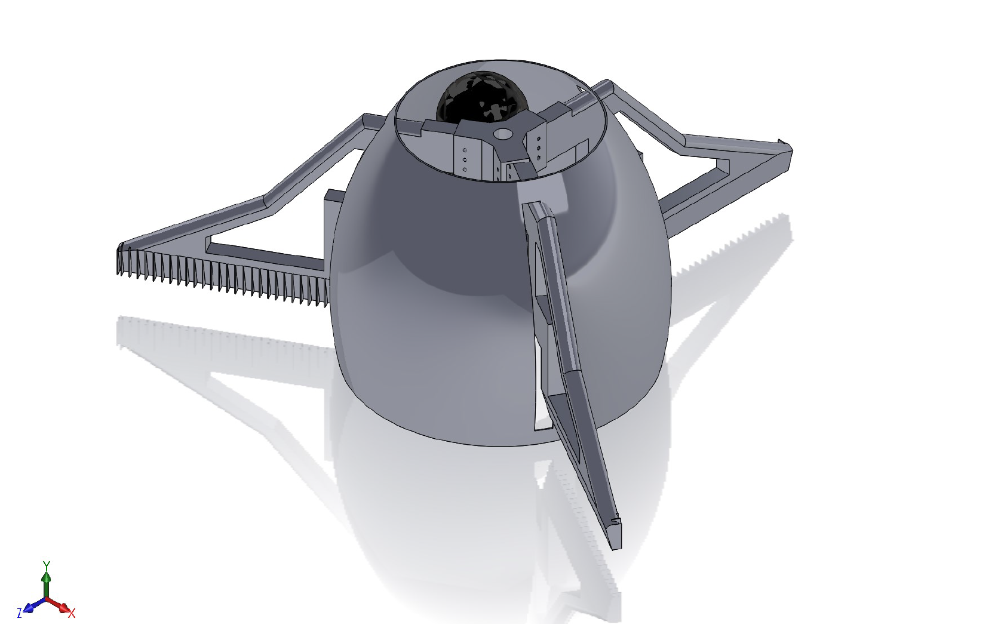
Design Planning and CAD
Fall 2016 Spring 2017

Slide 4
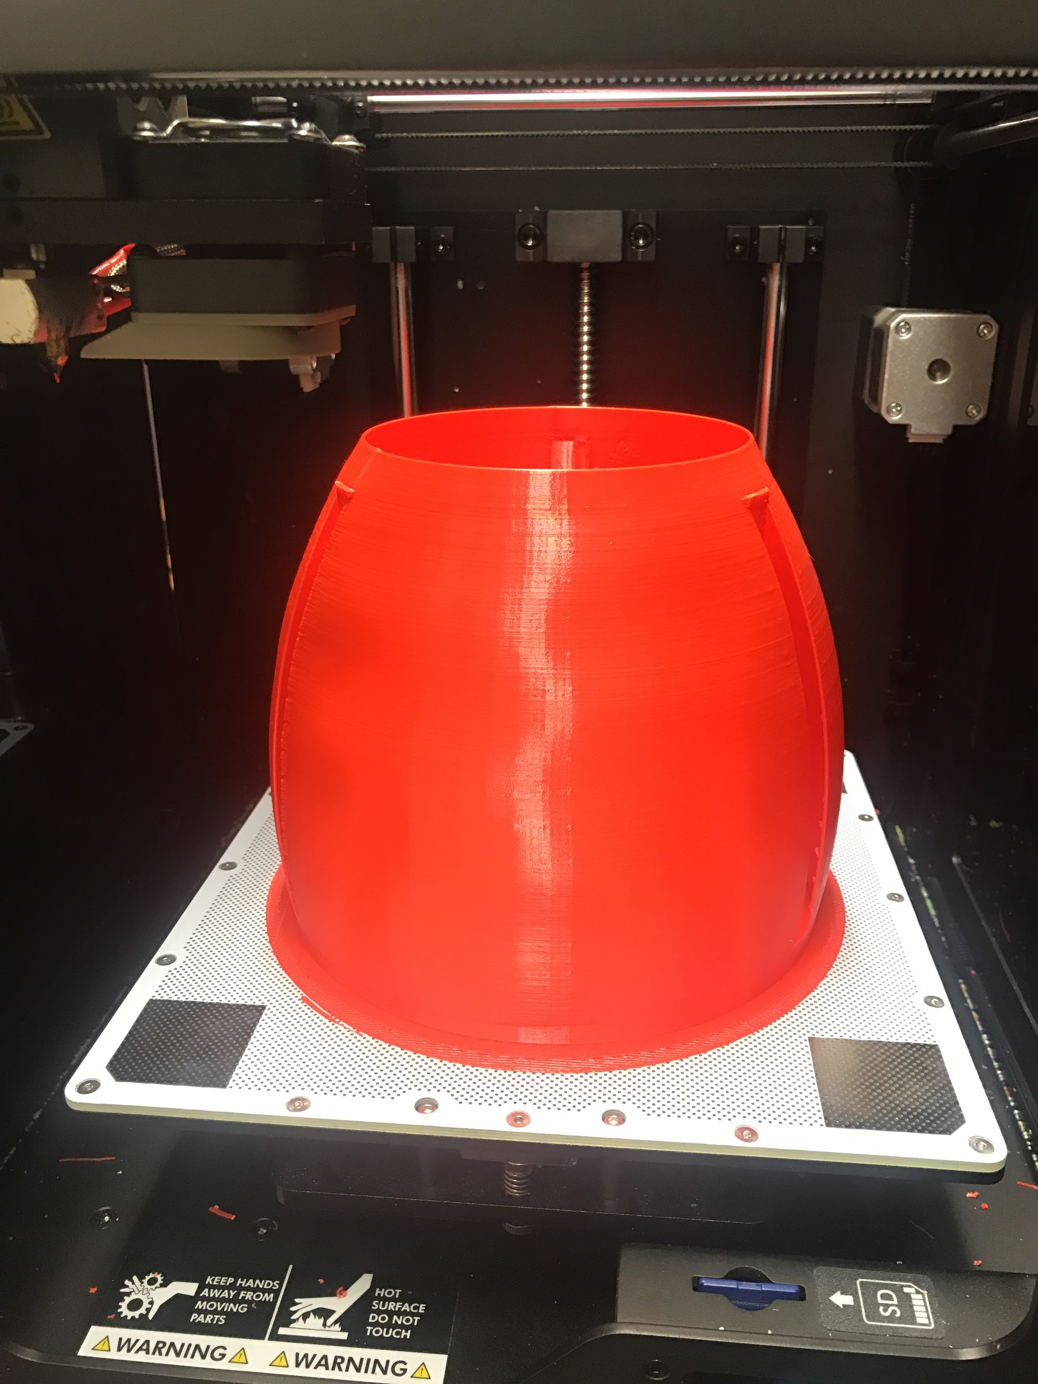
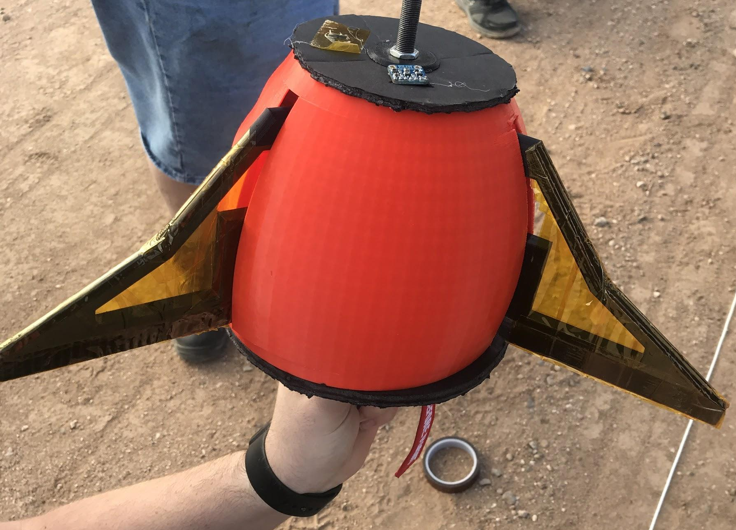
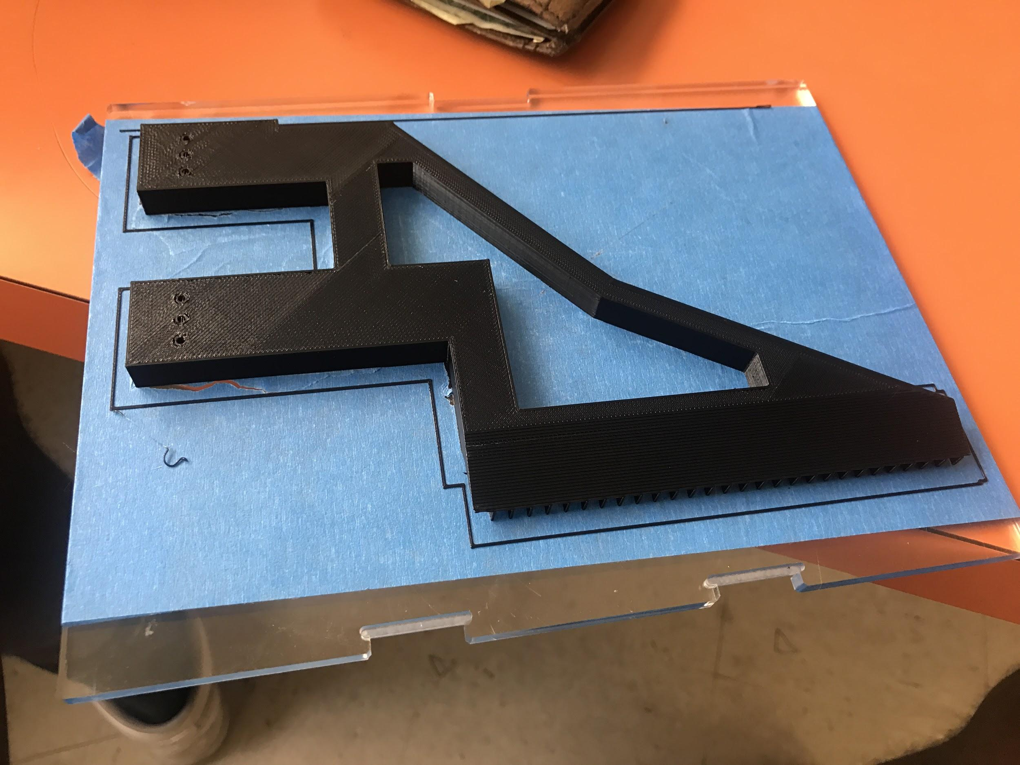
Fabrication
Experience goals
Large component printing
Third Party Fabrication
Combination of materials
  ABS
  PLA
  Lexan
  Carbon Fiber

Slide 5
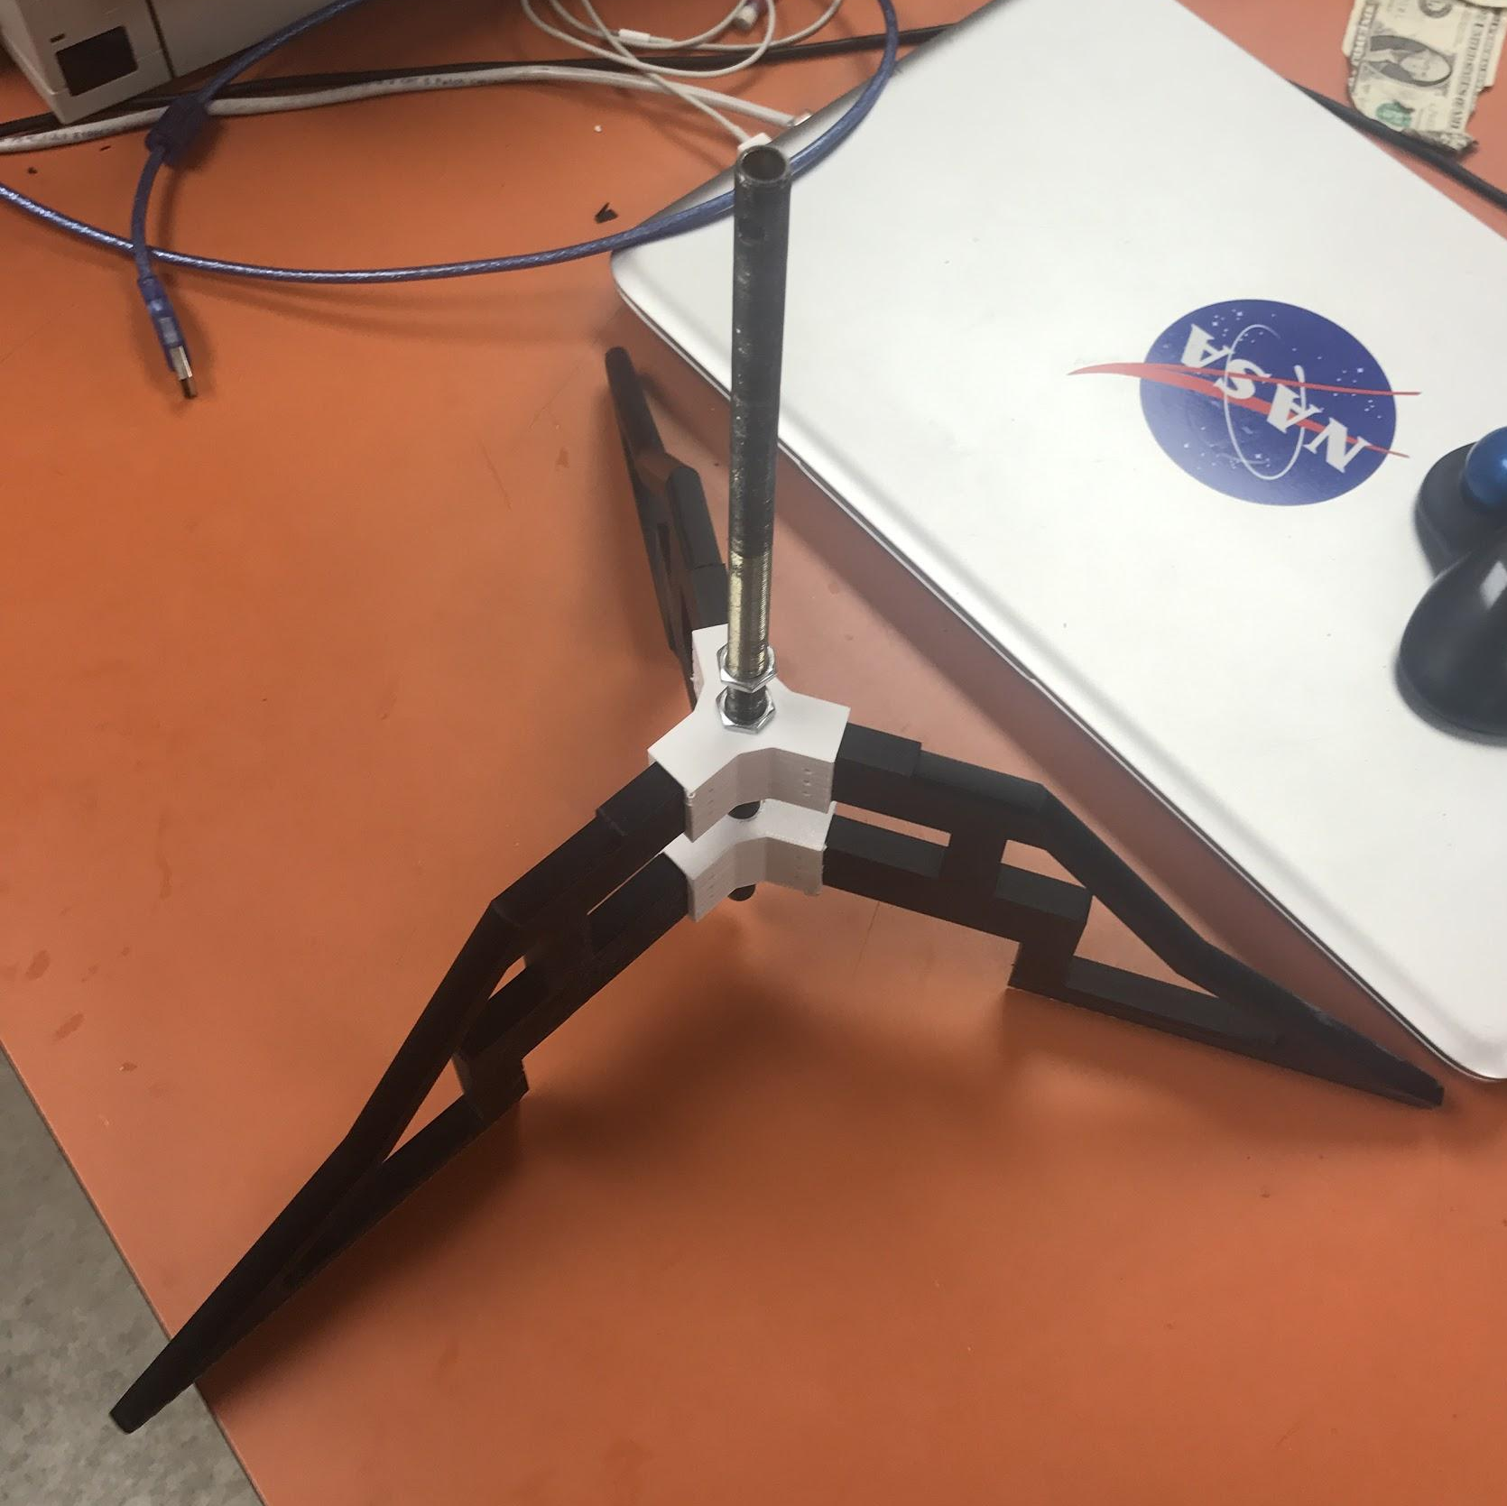
Dynamic and Stress Analysis
Experience Objectives
Flight Dynamics
Stress Analysis
Analysis of Failures
Contingency Planning

Slide 6
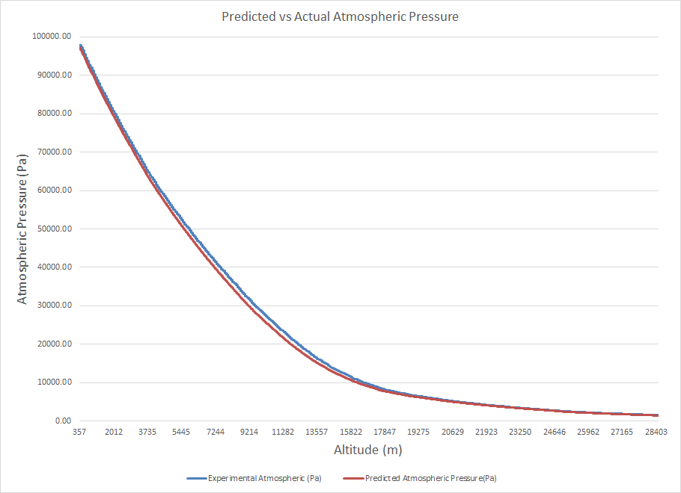
Dynamic and Stress Analysis
Experience Objectives
Flight Dynamics
Stress Analysis
Analysis of Failures
Contingency Planning

Slide 7
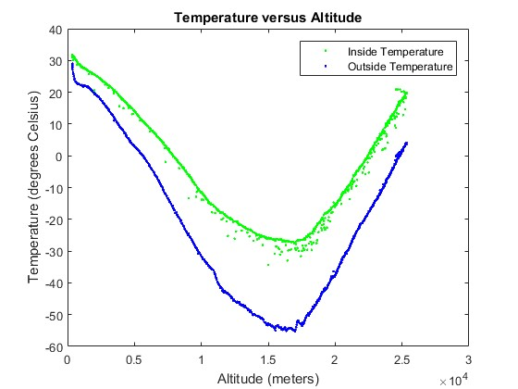
Data Analysis
Data collected from November 2016 flight. Science payload included:
  Accelerometer, magnetometer, gyroscope.
  Temperature, pressure, humidity sensors.
  Infrared, ultraviolet, visible light sensors.
Notes:
Consistent data patterns as expected from temperature and pressure sensors. Scattered data from magnetometer, light sensors.

Slide 8
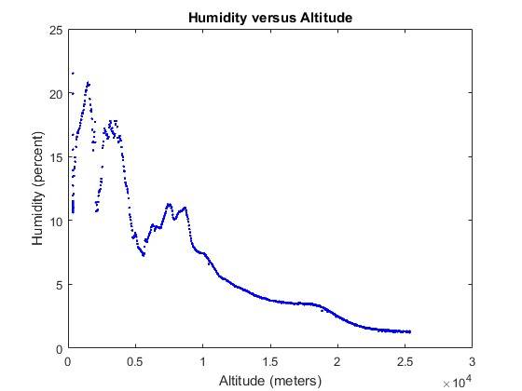
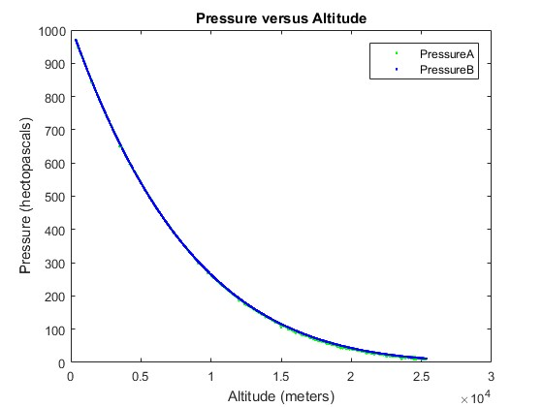
Data Analysis

Slide 9
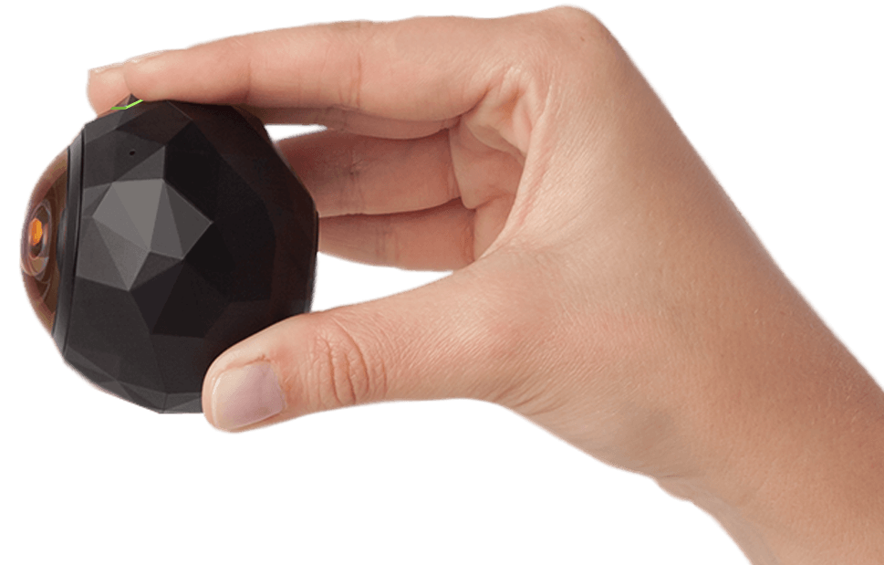
360 Camera
Full 360° horizontal x 240° vertical field of view
4K: 2880 x 2880 @ 30FPS Max
Accelerometer, E-Compass, Non-Assisted GPS, Gyroscope, Microphone
Up to 1.5 hours battery life
~172g weight
Dust & shock resistant
Internal 64GB storage

Slide 10
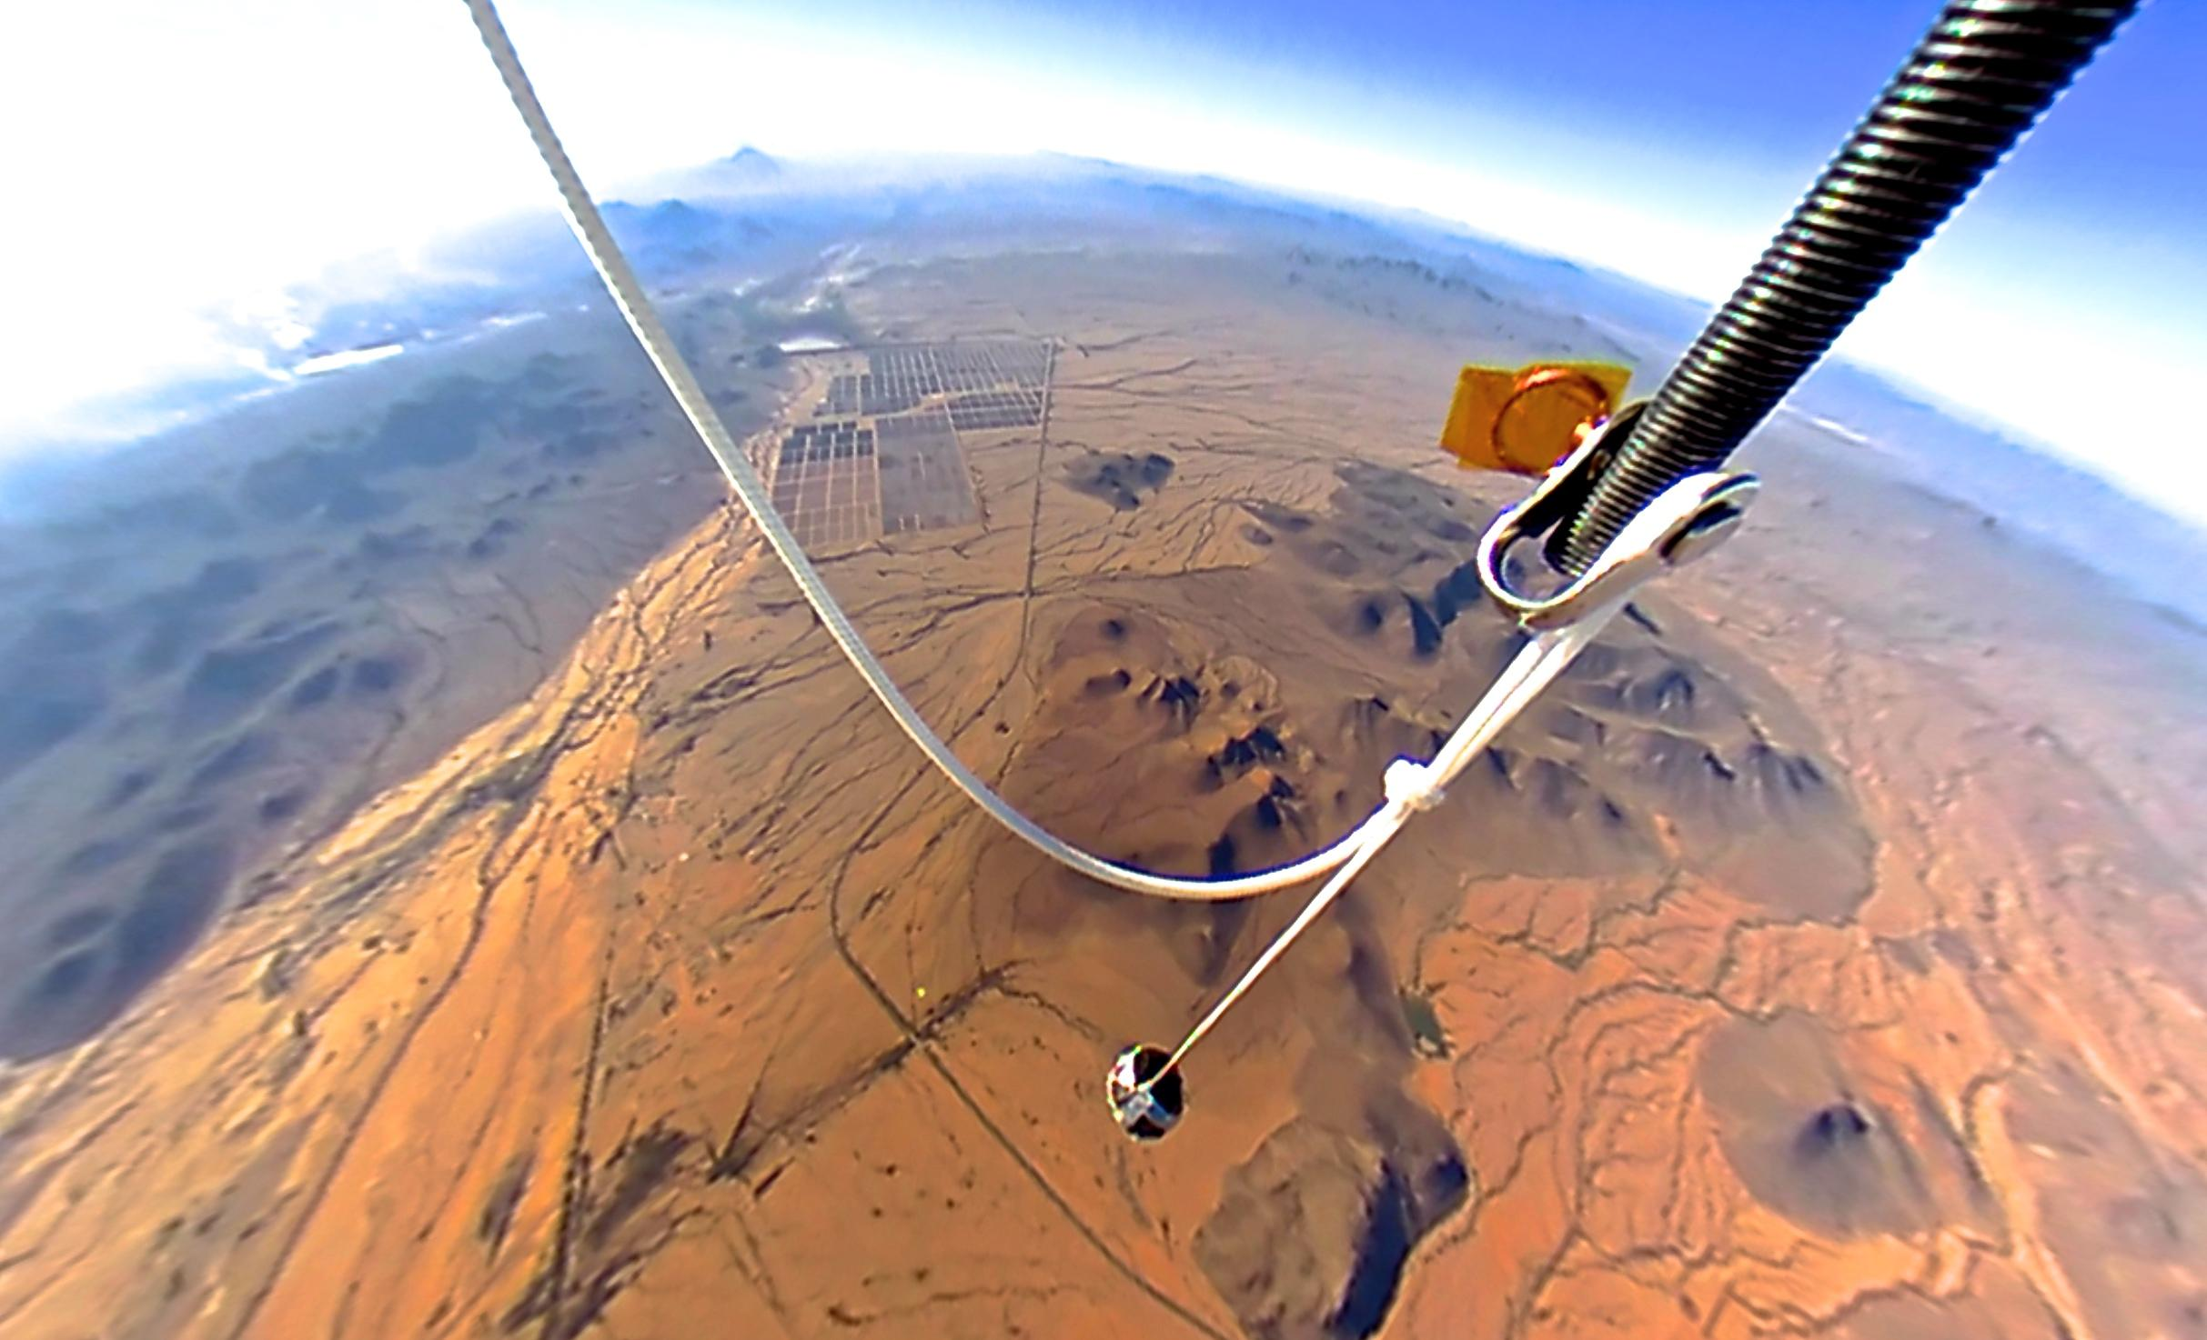
360 Camera

Slide 11
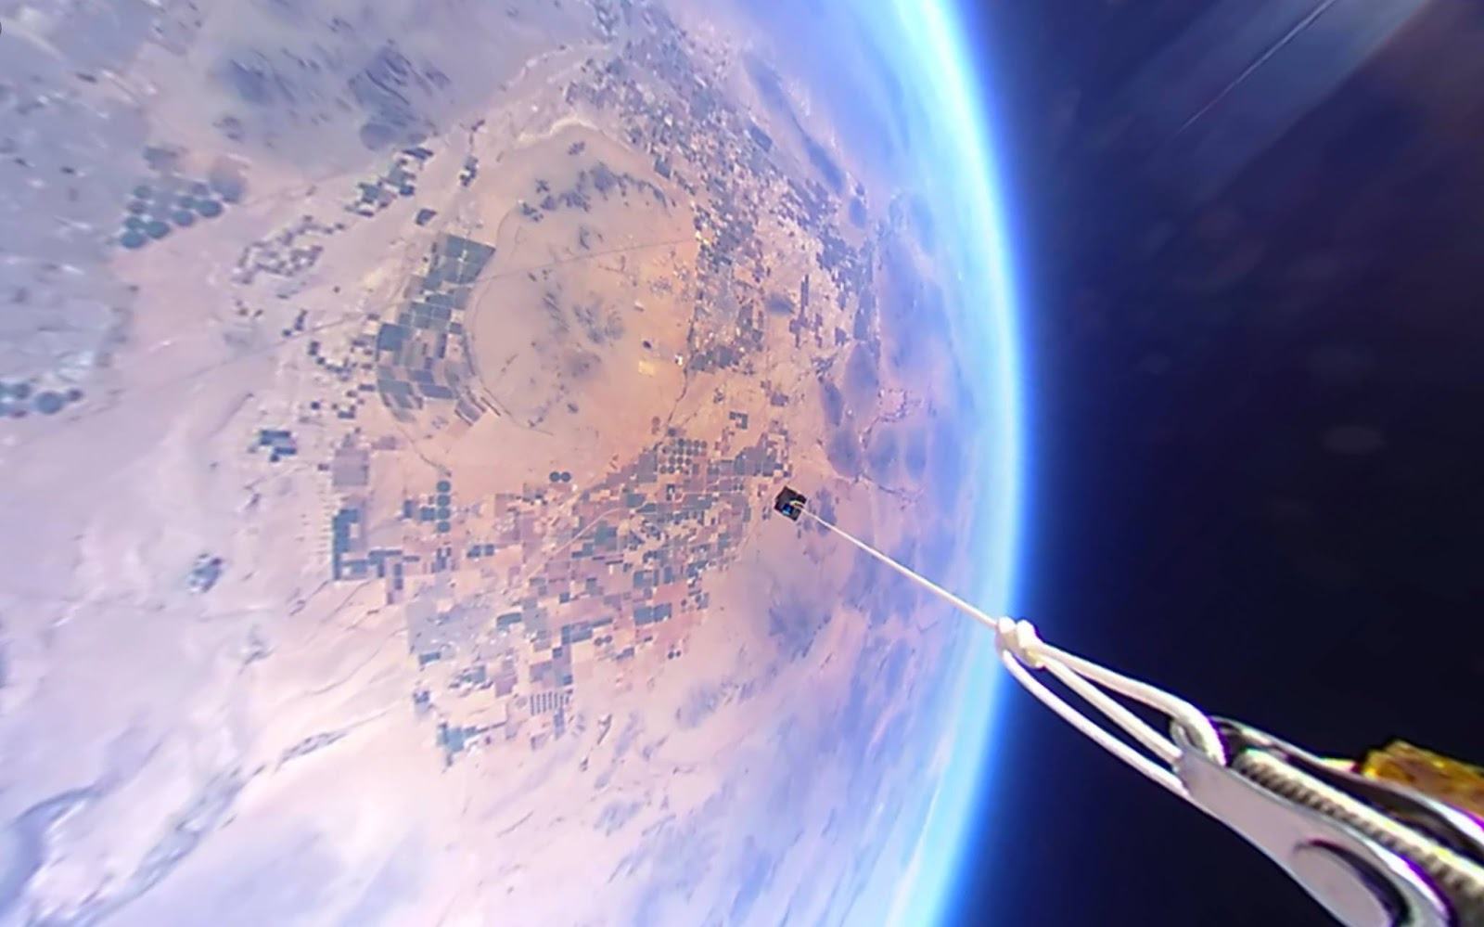
360 Camera

Slide 12
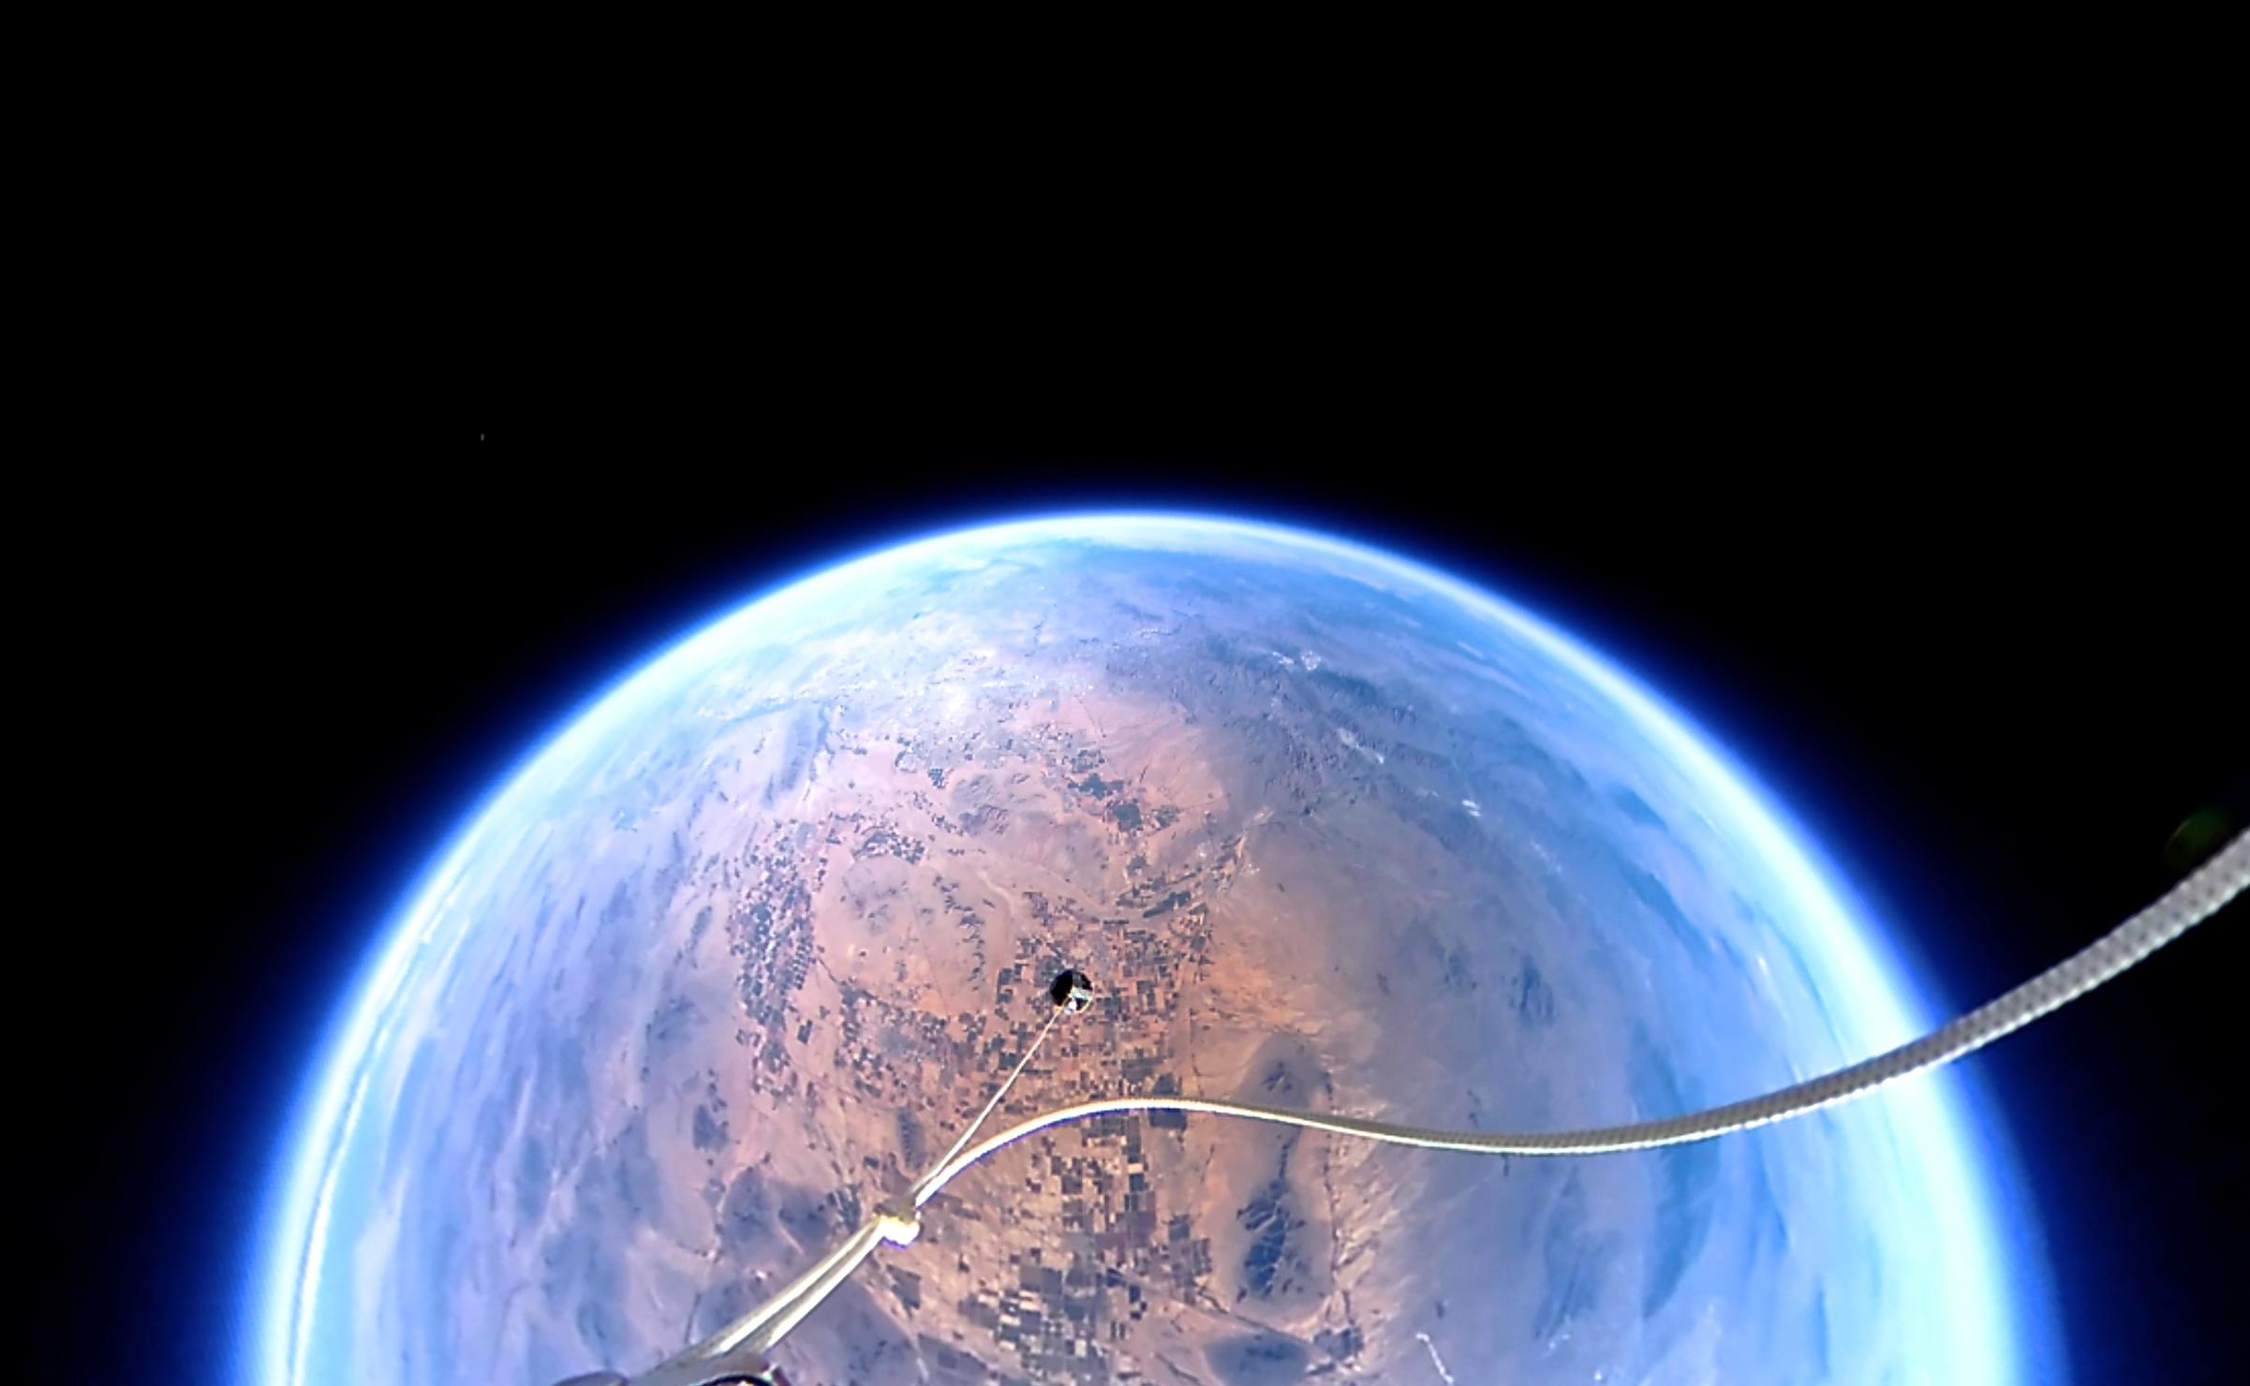
360 Camera

Slide 13
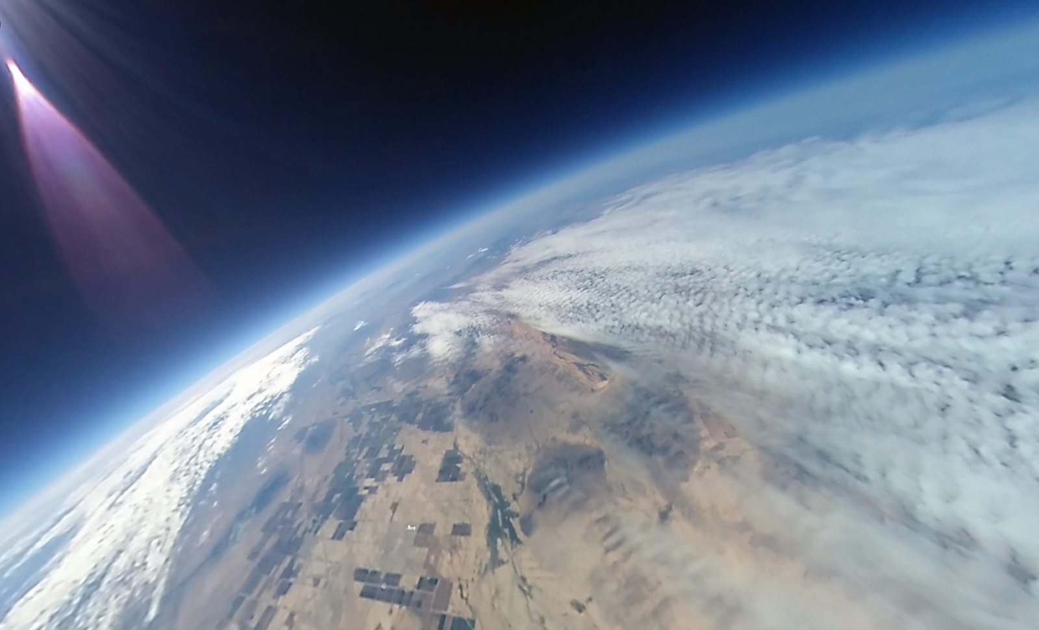
360 Camera

Slide 14
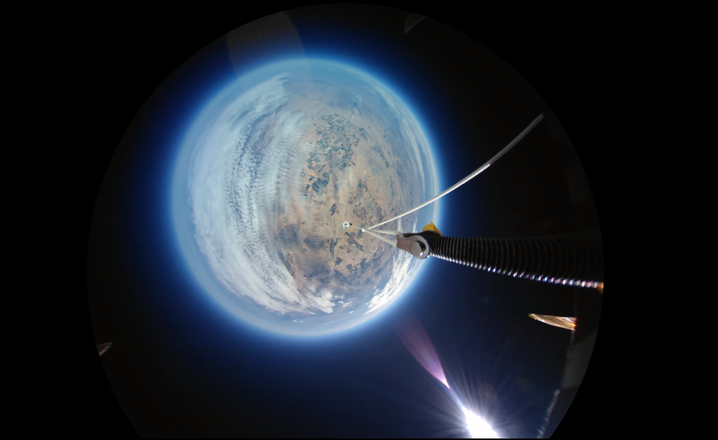
360 Camera

Slide 15

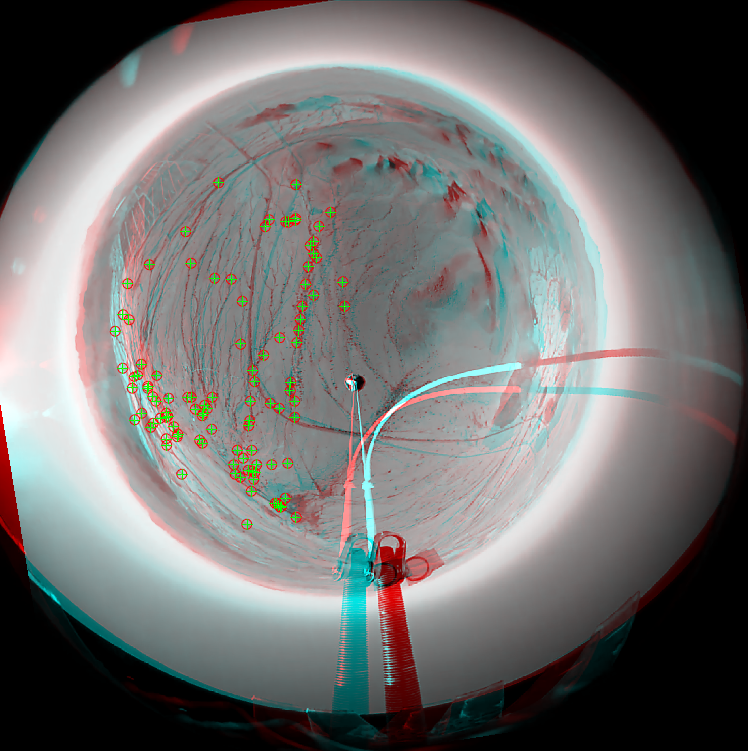
360 Camera Stabilization
Masking
Feature identification
Feature matching
Rotational correction

Slide 16
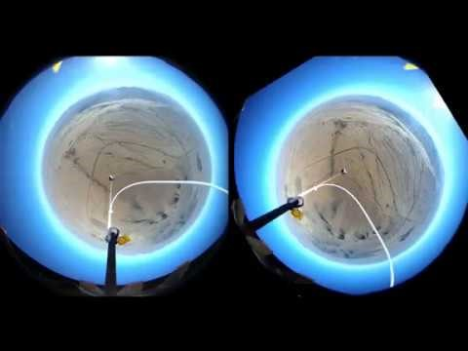
360 Camera Stabilization

Slide 17
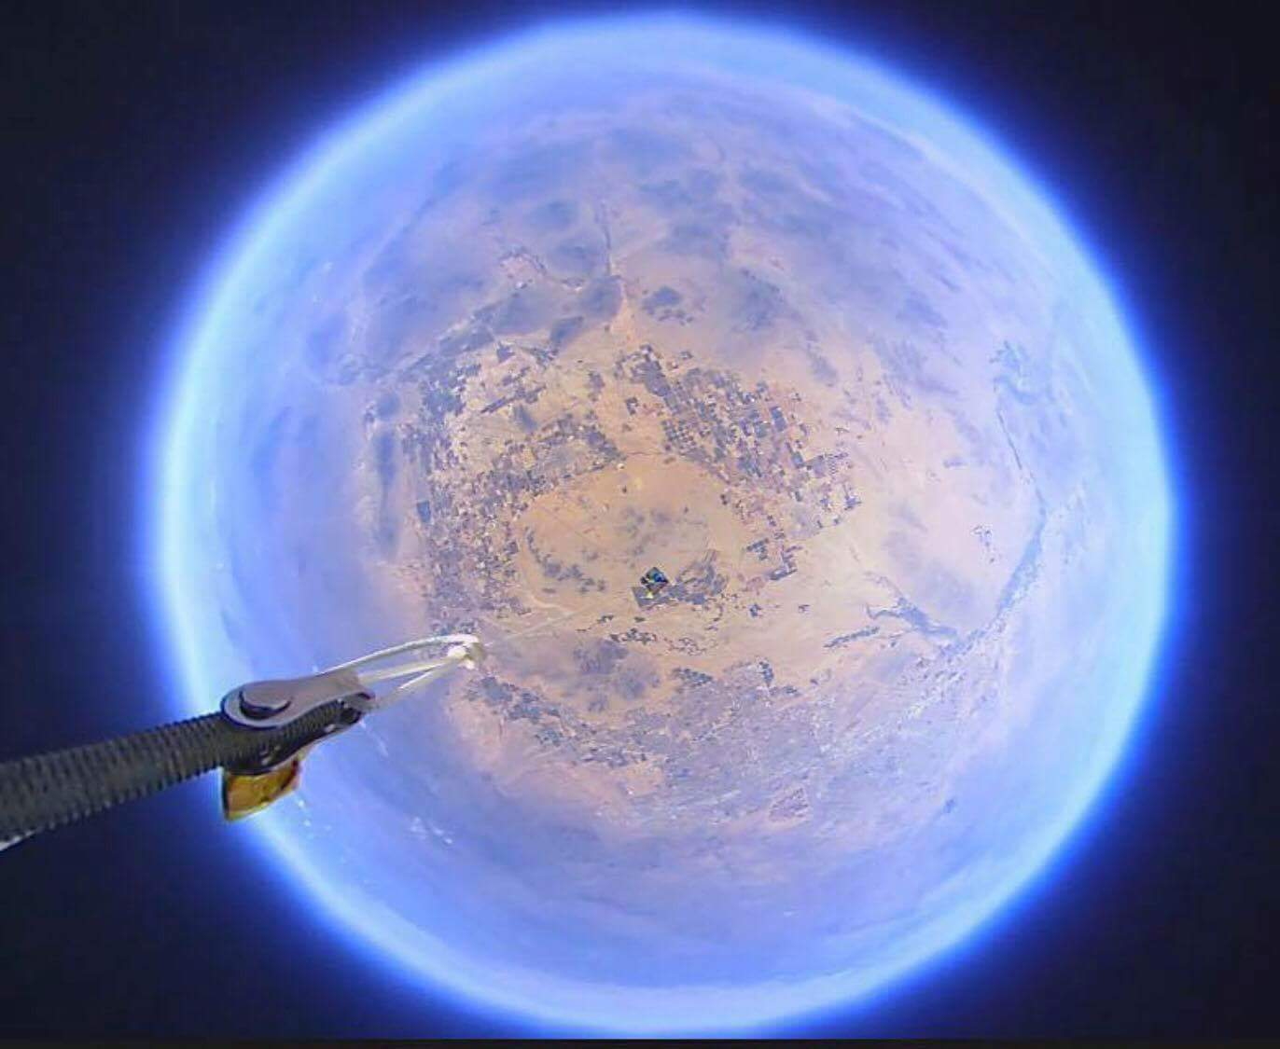
Thank You!
Susan Brew,
Arizona Near Space Research,
NASA Space Grant,
Arizona Space Grant Consortium

